Slide 1
Back End in Java for Information Processing
Develop - Sprint 1
Valeria ANEL DUQUE SALGADO NAO:3306

Slide 2
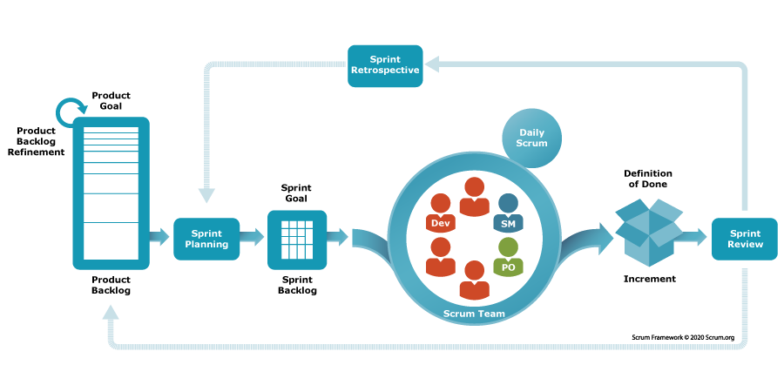
What is SCRUM?
Scrum helps people and teams deliver value incrementally in a collaborative way. As an agile framework, Scrum provides just enough structure for people and teams to integrate into how they work, while adding the right practices to optimize for their specific needs.

Slide 3
Roles
Product Owner → Defines the vision, manages the Product Backlog, and prioritizes work.
Scrum Master → Facilitates Scrum, removes impediments, and ensures the team follows Scrum practices.
Development Team → Cross-functional professionals who build the product.

Slide 4
Artifacts
Product Backlog → Ordered list of everything needed in the product.
Sprint Backlog → Items selected for the Sprint + plan to deliver them.
Increment → The working product delivered at the end of each Sprint.

Slide 5
Events (Ceremonies)
Sprint → Time-boxed iteration (usually 2–4 weeks).
Sprint Planning → Define Sprint Goal and select backlog items.
Daily Scrum → 15-minute daily meeting to synchronize and plan next 24h.
Sprint Review → Inspect increment and adapt Product Backlog.
Sprint Retrospective → Reflect and improve the team’s process.

Slide 6
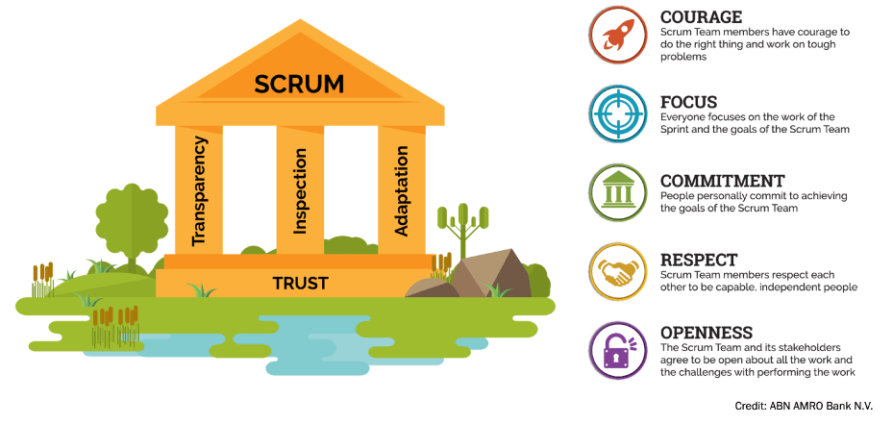
Scrum Values

Slide 7
Scrum Characteristics:
Self-Organized – Los equipos se organizan solos y toman decisiones.
Empowered – Tienen autonomía y recursos para cumplir objetivos.
Collaboration – Se fomenta trabajo en conjunto, aprendizaje y experimentación.
Shared Goal – Todo el equipo trabaja hacia un objetivo común.
Optimum Size – Equipos pequeños (6–10) para comunicación efectiva.
Diverse Skills – Equipos multifuncionales con distintas habilidades.
Collocated – Idealmente trabajan juntos físicamente, aunque se adapta a remoto.

Slide 8
JSON AND CSV

Slide 9
JSON
CSV
JSON is a data exchange format that stands for JavaScript Object Notation. JSON is known as a light-weight format type and is favored for its readability and nesting features. It is often used in conjunction with APIs and data configuration. More specifically, JSON is preferred for API use, which prioritizes file size due to its lightweight feature. JSON is also praised for its ability to be easily converted into other formats. JSON conversion tools are quite common, and there are many free JSON to CSV format conversion tools out there.
CSV is a data storage format that stands for Comma Separated Values. Implied in its name, CSV stores the data (values) in a list format separated by commas. CSV is noted for its small file size and simplicity. Likewise, because of its simplicity, CSV can be used by virtually anyone who is tasked with examining simple data in spreadsheets and tables. CSV files can be converted to JSON format, but complex JSON files may lead to reading and writing errors.

Slide 10
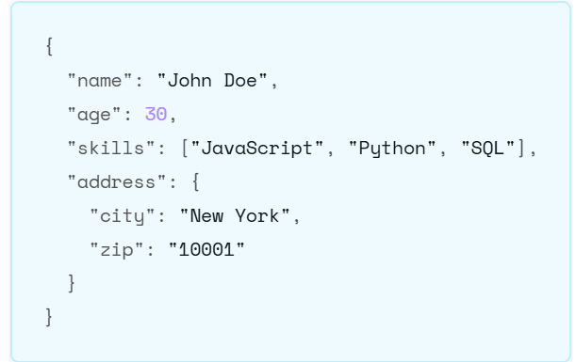
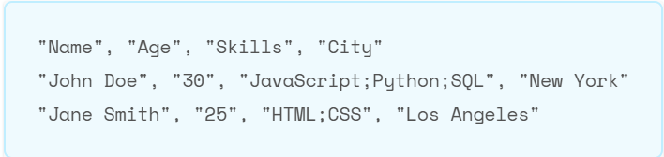
JSON
CSV

Slide 11
